Slide 1

TECHNICAL PRESENTATION
SUBTITLE: TRANSFORMING BUSINESS DECISIONS WITH SCALABLE DATA PROCESSING
CSA1511-CLOUD COMPUTING
UNDER THE SUPERVISION OF:
DR.HEMAVATHI.R
PRESENTED BY:
KEERTHANA.P (192521289)

Slide 2

OBJECTIVES
Objective
Understand Big Data Analytics in Cloud Computing.
Learn how cloud platforms process large amounts of data.
Study the architecture and working process.
Explore real-world applications.
Know the benefits, limitations, and future scope

Slide 3
Core Technical Explanation
What is Big Data?
Big Data refers to extremely large and complex datasets that cannot be processed using traditional methods.
What is Cloud Computing?
Cloud Computing provides storage, computing power, and software services over the Internet.
Working Process
Data is collected from multiple sources.
Data is stored in cloud storage.
Cloud platforms process the data.
Analytics tools extract useful information.
Results are shown through dashboards for decision-making.

Slide 4
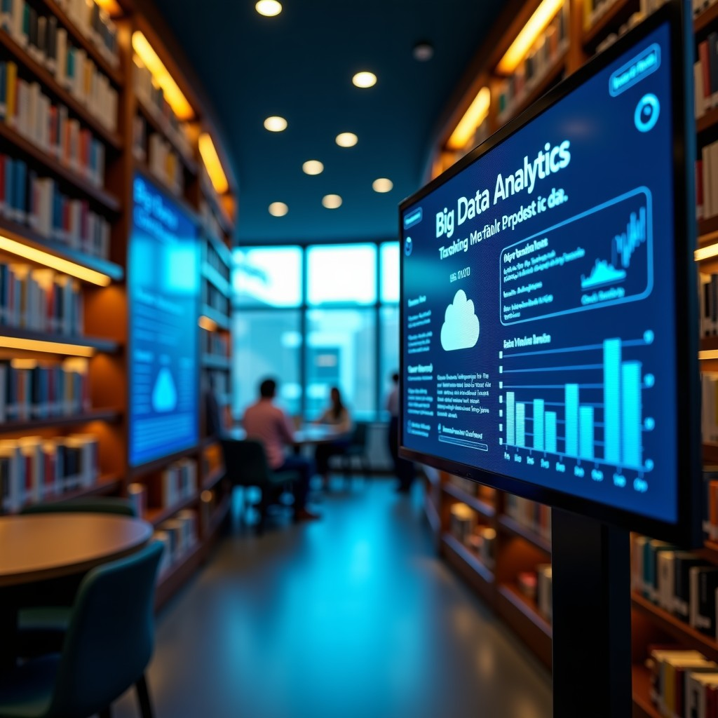
Real-World Use Case
Amazon Product Recommendation System
Amazon collects customer browsing and purchase data.
Data is stored in cloud servers.
Big Data Analytics identifies customer interests.
AI recommends products based on previous purchases.
This improves customer satisfaction and increases sales.

Slide 5

Conclusion and Key Takeaways
Conclusion
Big Data Analytics and Cloud Computing work together to process huge amounts of data efficiently. They help organizations make faster, smarter, and data-driven decisions.
Key Takeaways
Big Data handles massive datasets.
Cloud Computing provides scalable storage and processing.
Analytics converts raw data into useful insights.
Used in healthcare, banking, e-commerce, education, and smart cities.

Slide 6
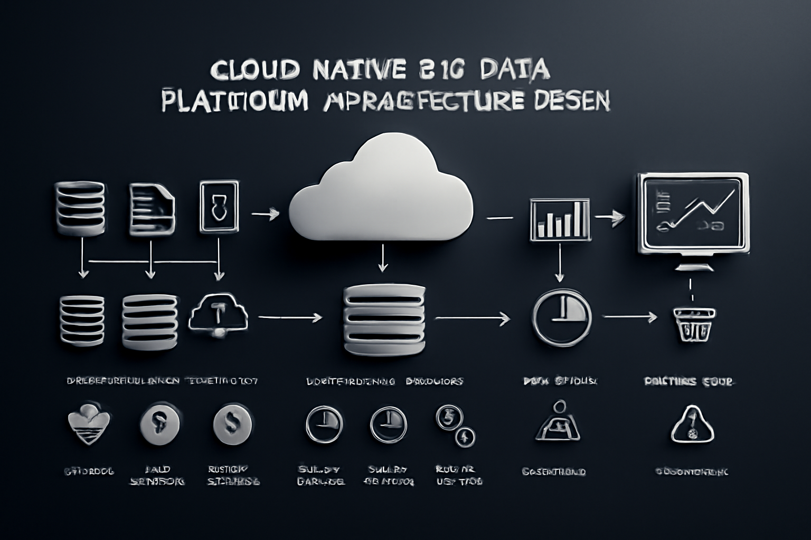
Limitations and Future Scope
Limitations and Future Scope
Limitations
Data privacy and security issues.
High storage and processing costs.
Requires skilled professionals.
Managing very large datasets is complex.
Future Scope
AI-powered analytics.
Real-time decision making.
Edge Computing integration.
Predictive analytics for businesses.
Smarter cloud platforms with automation.

Slide 7
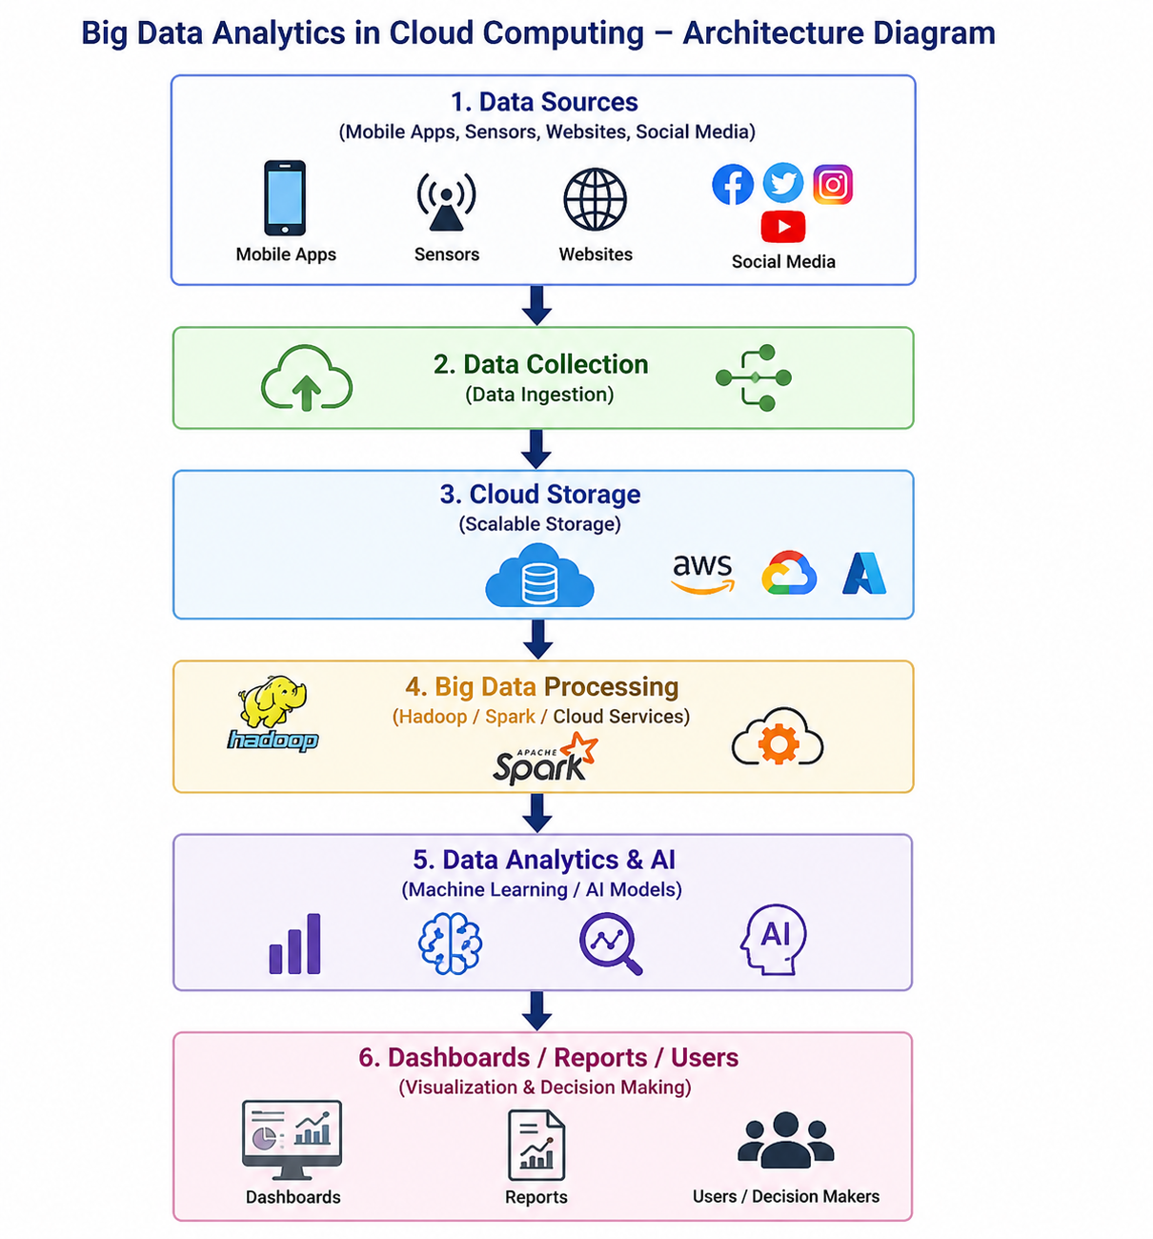
Architecture / Process Diagram

Slide 8
CONCLUSION
• Implemented a Python-based data pipeline on Google Cloud Functions, processing 5,000 customer interactions with 87% sentiment analysis accuracy.
• Achieved real-time analytics updates within 5 seconds for dashboard visualizations, a 75% improvement over traditional hourly batch processing methods.
• Leveraged Firebase NoSQL database for flexible data ingestion from diverse sources, supporting dynamic schema evolution for new data types.
• Current dashboard refreshes every 30 seconds; future work integrates WebSockets using Flask-SocketIO for immediate, real-time data visualization.
• This scalable data analytics framework empowers SMEs to make informed decisions, transforming raw data into actionable insights at minimal cost.

Slide 9
REFERENCES
[1] M. Ethan, "Big Data Processing in the Cloud: Scalable and Real-time Data Analytics," , 2024.
[2] M. P., .. Chidambaram, B. K. et al., "Real-Time Big Data Analytics for Cross Sector Decision Intelligence: A Scalable Framework for Transforming Enterprise Data into Strategic Action," Proceedings of the 1st International Conference on Research and Development in Information, Communication, and Computing Technologies, pp. 625-631, 2025.
[3] S. Kannan, "Implementing scalable cloud computing solutions for agricultural data management," Transforming Agriculture for the Digital Age: Integrating Artificial Intelligence, Cloud Computing, and Big Data Solutions for Sustainable and Smart Farming Systems, pp. 64-84, 2025.
[4] A. Sathi, "Introduction," Engaging Customers Using Big Data, pp. 1-17, 2014.
[5] C. Loebbecke, "Digitization, Big Data Analytics, and Artificial Intelligence Transforming Business, Society, and Research," Moscow University Economics Bulletin, vol. 2019, no. 6, pp. 9-11, 2019.

Slide 10
THANK YOU
Questions & Discussion

